Slide 1

OS Design When the OS Cannot Be Trusted
Adrien Ghosn – Candidacy Exam
29.06.2017
Notes:
Hi, I’m adrien and today I’m gonna talk about the modern need for a review of traditional OS.

Slide 2
Outline
Introduction
Challenges
Exokernel
Unikernel
Haven
Research Proposal
29

Slide 3













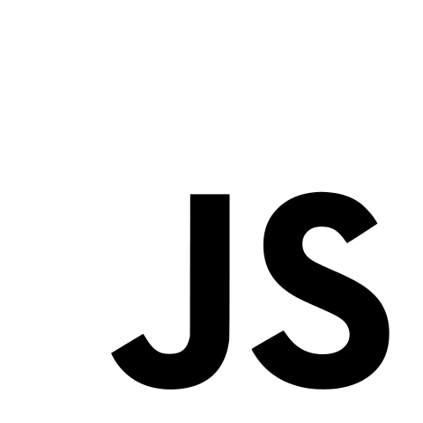












A (biased) Timeline
Computer World:
…
POSIX
My Graduation
…
68
70
77
81
85
88
91
95
2050
Notes:
To introduce the thematic, I decided to rely on a biased Timeline holding some of the important events of the past 50 years in the Computer world.
At the end of the 60s, we have the Arpanet, in 70 the Unix architecture appears.
I pick 77 for the Lisa 2 computer that, apparently, started the personal computer trend.
Then you have MSDOS, and a few years later Windows 1.
After that POSIX; the set of standards for portable operating system interfaces uni-X
Small leap, in the 90s you have Linux & the World wide web.
And then, suddenly, boom.
A formidable explosion in terms of numbers and diversity of applications, devices, hardware setups.
You have cloud smartphones, tablets, cloud services, many applications servicing millions of users, web dev frameworks.
All of that leading to an heterogeneous environment.
Meanwhile, popular operating systems did not evolve. They still expose the same rigid high-level abstractions.

Slide 4

Apps & OS: A Divorce
Non-flexible abstractions
Frameworks.
User-level (re-)implementations.
Non-satisfactory performances
Kernel bypasses.
Security model evolved
“Pirates are back!”
“Don’t trust the Cloud… or ANYTHING!”
“You’re worth less than the data you produce.”
Notes:
And this leads to important issues.
First, it limits the application’s flexibility. To implement new abstractions, app developers have to emulate them on top of existing ones, sometimes inneficiently.
To improve their performance, they have to rely on kernel bypasses and reimplement system services in a different way, closer to their needs.
And last but not least, our security requirements have evolved.
We have pirates/hackers trying to steal information and compromise machines, we live in world where sensitive user data is generated everytime we interact with our machines.
The way we deploy and execute applications changed, we have cloud services, where you host sensitive data on machines that you do not control, you have user info aggregation by the OS or some of the apps on your phone.
Your data is now worth a lot and many entities want it.
These new complex requirements cannot be answered by the traditional hierarchical security model where you can trust a host/privileged code, and do not trust the guest/app.
As a result, we need to rethink re-design our OS to answer those concerns.

Slide 5
Desired Features
What do we really want from a modern kernel?
Performance for heterogeneous applications.
Ease of deployment, e.g., for Cloud platforms.
Support modern security model, e.g., bi-directional isolation.
Notes:
More specifically, we would like to
Allow heterogeneous applications to all achieve good performance.
We want to be able to support heterogeneous hardware setups and deployments, as for example, the cloud.
We want to provide a modern security model, one where we allow distrust between privileged and unprivileged code, host & guest.

Slide 6
How can we achieve this?
Claim: All three requirements can be satisfied with a common set of design principles!
Performance
Deployment
Security
Exokernel
Unikernel
Haven
Notes:
We actually claim that all of this is achievable if we follow a common set of design principles.
For the performance aspect, we’ll study the exokernel architecture.
For the deployment, we’ll inspire ourselves from the Unikernels.
For the security, we’ll study how Haven provides bi-directional isolation between a host & a guest.
We’ll show the design principles behind each of these systems, and highlight the common approach taken by all these papers to try & identify the features needed for our own design.

Slide 7
Exokernel & Performance
End-to-End, Separation of protection & management
Separation of policies & mechanisms
Notes:
So let’s start with the Exokernel & the performance aspect.

Slide 8


Motivation
Problem: No single, fixed, implementation for high-level abstractions can provide best performance for ALL applications.
So, what can we do?
Answer: Surrender! Just don’t try to do it!
Notes:
The motivation, as announced during the intro, is that thehigh-level rigid abstraction provided by popular operating systems cannot possibly satisfy all applications due their heterogeneous requirements.
First, applications that do not require a particular feature still incur the associated cost.
Second, new abstractions have to be emulated on top of existing ones.
And finally, you deny applications to optimize resource management efficiently and according to their needs.
The authors stated this back in 95, and this observation has grown even truer in the past decades with the apparition of so many diverse applications.
So what can we do?
Well, just don’t try to provide these abstractions! Give up !

Slide 9
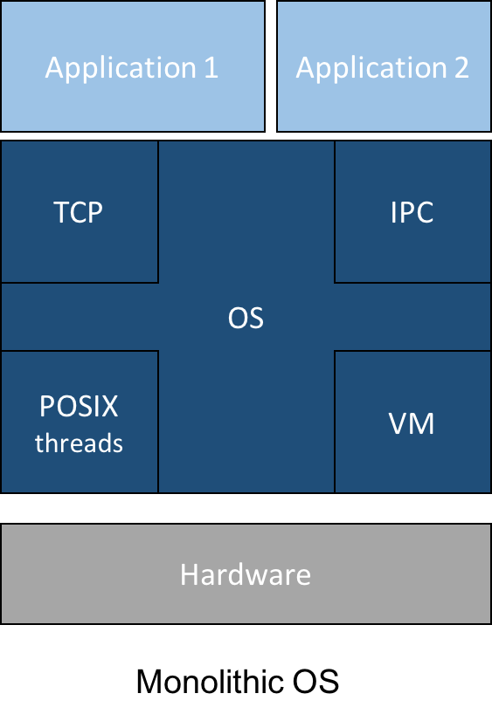
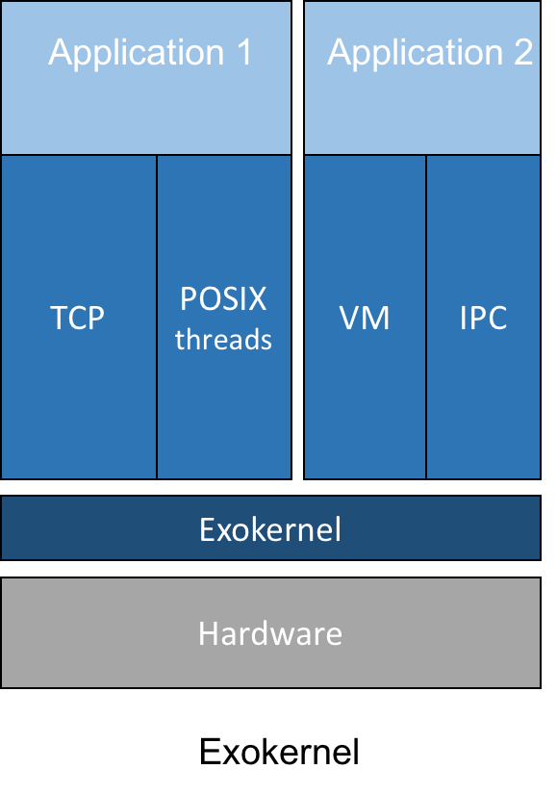
Exokernel Architecture
Notes:
Let the kernel do one thing, and do it well, and allow the application to implement its own abstractions efficiently.
If we compare the designs here, we see that a traditional OS contains all system services and fixes their implementations and high-level.
So for example you have APP1 that only wants to use TCP and POSIX threads.
APP2 wants virtual memory and IPC. But they do not have control over the implementations of these abstractions.
In the exokernel, the applications actually implements its own abstractions. The new shade of blue introduced is a Library operating system picked by the application itself. The kernel, in turn, is only responsible for exposing the underlying hardware resources.

Slide 10
Exokernel Design
Principle
Translates to…
End-to-End
Sep. protection & management
Avoid management
Sep. policies & mechanisms
App-level physical resource mgmt
Securely expose all hardware
Use physical names
Secure bindings mechanisms
Notes:
The design proposed by the exokernel to allow greater flexibility, to improve performance, and to avoid limiting functionality is based on a simple principle: allow application.level management of physical resources.
The application knows best (that’s the end-to-end principle).
This requires to separate protection from management, that is, the kernel must focus on securely exposing physical resources to the application, while avoiding as much as possible performing management.
Avoiding management requires to use physical names for resources, otherwise you introduce a level of indirection and forcefully perform some management.
Finally, the exokernel needs to separate policies & mechanisms. That is, to provide a flexible system, the mechanisms that enforce the secured multiplexing of resources and their protection should not limit the policies. In the paper, they call these “secure bindings”, and these mechanisms are at the heart of the exokernel’s design.

Slide 11
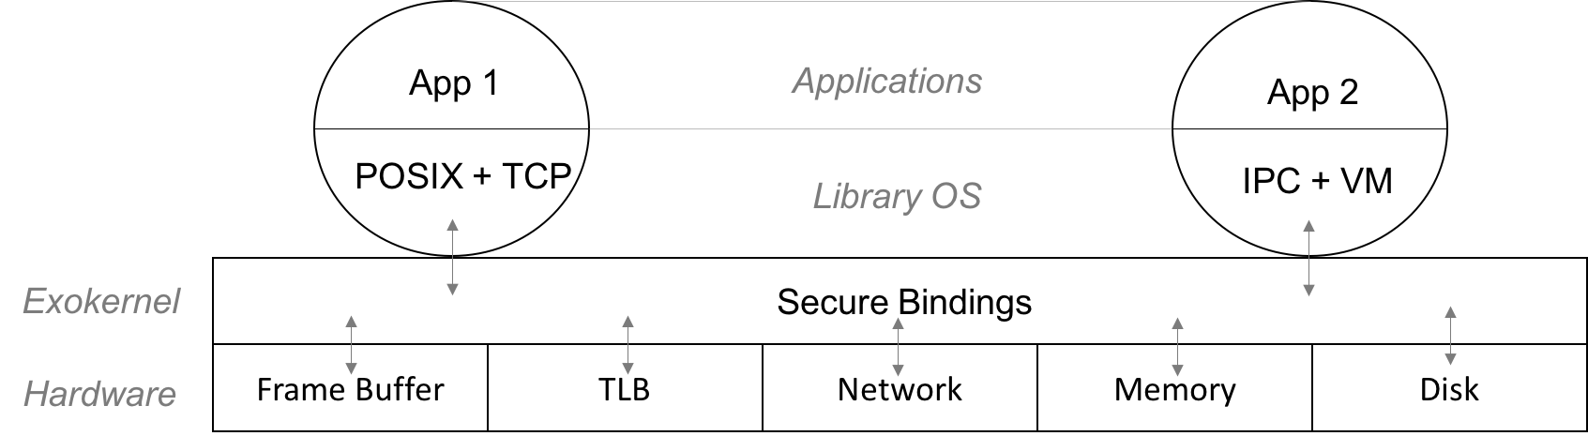
Exokernel Mechanisms
Secure Bindings
Hardware.
Software.
Code Download.
Revocation protocol
Abort protocol
Notes:
The secure bindings, the revocation and abort protocol are the essential mechanisms provided by the exokernel.
The secure bindings come in three flavors.
Hardware features should be leverage whenever possible in order to efficiently implement secure bindings.
For example, to bind a memory page to an application, the exokernel can rely on hardware features.
If a hardware translation lookaside buffer (TLB) is available and modifiable by software, it can install a virtual to physical mapping TLB entry for this page.
This is the “bind time”.
The hardware can then perform access time checks efficiently.
If such a TLB is not available, or to speed up the performance of the system, a software TLB can be used. The software TLB caches valide bindings and allows to either quickly check an access, or install a new entry in the hardware TLB.
Finally code can be safely downloaded inside the kernel. This provides access time checks closer to the application’s logic and allows checks to be performed even when the app is not scheduled.
The authors present packet filtering example. Without this, you would have to run every single application for an incoming packet.
The revocation protocol provides visible resource revocation. It basically involves the app in the process of revocation, which avoids having to perform resources management, understanding how resources are used, and allows application-specific policies to select resources to release.
The abort protocol allows to deal with applications that fail to comply with the revocation protocol.
Both these protocols are vital in the presence of scarce resources.

Slide 12

Exokernel Discussion
Good
But…
Efficient.
Clear separation between host/guest.
Close to cloud logic.
Heterogeneous hardware makes it unpractical.
Virtualization!
Notes:
So now, we can discuss about the exokernel design. First, as reported by the authors in the original and subsequent papers, it is efficient. The kernel’s taks are small and can be efficiently implemented. The kernel is small, which makes it less prone to bugs, and reduces the attack surface it exposes.
Second, it provides a clear separation between the host (kernel) and the guest (the application).
Which is actually a first requirement for the bi-directional isolation that we desire.
Finally, it’s close to the Cloud logic. If you think about it, a cloud service provider rents resources to you.
But, on the other hand:
The secure bindings, which are at the heart of the exokernel design, require hardware support to be efficiently implemented.
Do to the diversity of devices that are now on the market, this is unpractical.
If we take back our example for physical memory, the solution described by the authors requires to be able to install new TLB entries, which can’t be done with the latest Intel processors.
A practical implementation of the exokernel would then require to either limit it to a small set of hardware setups, or try to cope and provide implementations for all possible ones, which is not possible.
So what can we do?
Well, virtualization is a solution !

Slide 13
Unikernels & The Cloud
Library operating system, Virtualization, High-level programming languages
Notes:
And that’s actually one of the points made by the Unikernel authors.

Slide 14

Motivation
Problem: Single-purpose VMs deployed in the cloud are not specialized!
Ad-hoc configuration.
Consumes more resources.
Large attack surface.
Notes:
But first, let’s talk about the motivation behind this project.
Traditionally, application are deployed in the Cloud as virtual machines. The VM packs an entire OS (like Linux) and runs unmodified application processes, which, in most cases, is one application supported by smaller services.
We can see VMs in the Cloud as single purpose appliances.
This model, however, presents several shortcomings.
First, to glue services together, developers often rely on ad-hoc scripts that start all the required parts.
Second, even though they might not be needed, all functionalities that come with the guest OS are packed within the VM image, which increases its size and the potential attack surface.
For example, an unriquired service, running by default, such as an openssl server, can be leveraged by an attacker to subvert the VM.

Slide 15


Unikernel Design
Library operating system…
… On top of a Hypervisor!
EVERYTHING in one high-level PL.
Compile application & LibOS together.
Static Analysis & Verification tools.
Type safety
Notes:
That’s what the unikernels try to solve.
Inspired by the exokernel, unikernels are standalone highly specialized sealed appliances.
To overcome the limitations due to heterogeneous hardware setups, unikernels run on top of a hypervisor (Xen here).
The application, as well as the library operating system, are written in a high-level programming language (here Ocaml) and compiled at once! This allows to perform system wide static analysis at compile time and optimization.
The same set of tools can be used on the entire user stack.
Finally, the choice of a high-level type-safe language enables to improve the system’s security.

Slide 16
Unikernels
Problem
Solution
Configuration.
Size of appliance.
Security.
Compile time!
Order of hundreds KB!
DCE & Type-safety!
Notes:
If we go back to the VMs limitations introduced before, we see that Unikernels actually answer all of them with a very simple design.
All the static configuration is done at compile time by linking the desired libraries to the application’s code. Hence, there’s no need to write tedious scripts to glue services together, everything is done by the compiler.
Second, compilation techniques such as dead-code-elimination allow to remove unnecessary code from the final image.
Only used services are included, which drastically reduces the size of the appliance, and hence requires less resources to host the program’s code and data on the cloud.
Another advantage of DCE is that it reduces the potential attack surface exposed by the unikernel by removing unnecessary features.
Furthermore, as the entire stack is implemented in a type-safe language, the appliance is less prone to bugs and certain categories of attacks.

Slide 17

Unikernel Discussion
Good
Less good…
Performance
Portability.
Security.
Deployment & resource usage.
Less fine-grained than exokernel.
OCaml…
Notes:
The take-away from the Unikernel are that, first, they are well-performing (comparable to state-of-the-art implementations running inside VMs).
Second, it improves upon the exokernel by relying on virtualization to achieve a high degree of portability.
Then, as we have seen, it provides extra guarantees in terms of security by integrating high-level programming features.
And finally, its small size represent an important advantage for cloud deployments as it can be easily transferred across the internet and potentially consumes less resources than an equivalent VM to host its code and data.
On the other hand, compared to the exokernel, it sacrifices flexiblity for portability.
Relying on virtualization prevents it from performing the fine-grained management of physical resources described in the exokernel.
However, it is actually hard to evaluate without further experiments how this loss of flexiblity actually translate into a potential loss of performance.
Another important point is that the entire stack needs to be reimplemented in Ocaml, or whatever programming language is picked, which sounds like a huge engineering effort and precludes backward compatibility.
At the same time, since cloud applications are so-specialized, and since most languages provide libraries with a lot of functionalities, I assume that it might be more feasible than it sounds.
Good, so now we have seen how to allow performance, and how to tweak the exokernel’s design to actually support deployments over the cloud and obtain some portability.
All that is left is to study how to integrate bi-directional isolation in such a design.
That’s what we’ll do with the next paper.

Slide 18
Haven & Security
Intel SGX, Separation of policies & mechanisms, Mutual distrust
Notes:
Now we’ll talk about microsoft research project called Haven and see how to provide bi-directional isolation between a host and a guest.

Slide 19
Motivation…
Why do people use cloud services: IaaS, SaaS, PaaS, WaaS AaaP*?
Because:
How it works:
Fast deployment.
Low start-up cost.
Adaptability.
Sounds fancy.
“You have to share!”
Co-located apps.
“Wrap it!”
Containers, VMs, etc.
“I won’t look… I promise.”
CSP privileged.
*This one is made up.
Notes:
But first, a small introduction.
Cloud services are becoming very popular.
They allow even small size organizations to quickly deploy their application at a low start up cost.
You can also adapt the amount of resources rented according to your current load very easily.
Finally, it sounds fancy, and is a popular term, just like machine learning & big data, and everybody wants to get in on it.
So in practice (and at a high-level) how does it work?
The Cloud Service Provider is responsible for running your application on a machine. In order to use resources efficiently, several apps, from different source, might run on the same physical machine.
The CSP therefore needs to ensure that everything is secure.
An application should not be able to impact another one that is collocated on the same machine.
The CSP relies on various forms of sandboxing, like containers or VMs.
Since the CSP needs to manage all the apps, it retains control over the physical machines and runs a management software stack.
Meaning that the CSP is actually privileged.
That implies that a CSP has direct access to all data and code of the application.
If we take a step back here, we see that the isolation model strives to protect the host from applications, the applications from each other, but does not restrict the host from accessing application's code and data.
But that's fine right, the Cloud service provider is nice and can be trusted, what could go wrong?

Slide 20




…De-motivation
But what happens to data confidentiality and IP if we have a…
Corrupted host?
“Pirates are back!”
Malevolent host?
“I need your data for something…”
“Solve the rebus”
What now?
Notes:
Well, what if the CSP gets compromised?
Cloud services are a perfect target for hackers.
If you manage to corrupt the host, you'll get privileged access to every single application that runs on the machine.
But that's not all.
Privacy and confidentiality are growing concerns.
Allowing the CSP to aggregate data related to your users is something that you'd like to avoid.
Finally, while hackers are a threat, we should not forget that some governments or agencies have a long history of trying to get their dirty hands on private user data.
(I won't name anyone but you can solve the riddle if you want).
So what can we do about it ?

Slide 21


Haven - Thanks Microsoft.
Unmodified legacy applications
Shielded execution
Confidentiality
Integrity
Leverages Intel SGX
Provides feedback.
Notes:
That’s where Haven comes into play!
Haven allows shielded execution of unmodified applications.
What does shielded execution means?
It allows to protect confidentiality and integrity of the program's data, even from the privileged host.
Confidentiality means that no intermidiate state can be observed by the rest of the system, while integrity guarantees that if the program terminates, the output is correct.
Haven relies on Intel SGX, a new extension to the Intel processors that I'll present now.
Worth noting, Microsoft research got the specs for SGX, tried to implement Haven, and provided feedback to intel regarding the desirable features that should be added to it.

Slide 22
Intel Software Guard Extension (SGX)
Enclaves
Encrypted portion of address space.
Protected against modification…
… even from privileged code!
CPU in enclave mode
EPC.
Encrypted traffic to DRAM.
Attestation mechanism
App must know about SGX.
Before loading nothing is safe.
Iago attacks.
DoS.
Notes:
So what's intel Software Guard Extension?
It allows to create enclave, a portion of the user space that is not modifiable, even by software running at a higher privileged level.
To access and modify such memory regions, the CPU needs to be in enclave mode.
It has private datastructures that allows it to keep track of pages that belong to the enclave
Data that resides in the RAM is encrypted and integrity protected.
Any attempt to modify it will trigger a fault.
SGX also provides an attestation mechanisms.
You can see this a simple hash of the initial state of the enclave.
The hash is signed by the processor. This allows to verify that some software was correctly loaded for example and that the enclave was properly initialized.
While SGX provides nice tools that would help protect an application from a corrupted host, it is still not enough.
First, your application needs to be coded using the SGX API, meaning that you cannot run legacy applications, and you require developers to learn how to use this new feature.
Second, before loading, nothing is safe!
It is up to you to actually find a secure protocol to load data within the enclave without leaking any information to the host!
Third, the application would still rely on the os services and would be amenable to Iago attacks (a host that tries to subvert an application by returning erroneous results to system calls).
So one requirement is to limit the interactions between the host and the guest.
Finally, the host can perform denial of service attacks on the application.
That part of the threat model and is not addressed, even by Haven.

Slide 23
Haven Design
Separation of “policies & mechanisms”
Host is responsible for physical resources.
Guest is responsible for virtual resources.
Restrict interactions between host and guest.
Defend against malicious host EVERYWHERE.
Notes:
So Haven tries to address these limitations.
First, they separate policies & mechanisms by leaving the host in charge of physical resources while the guest handles all the virtualized ones.
This enables efficient verification and limits the scope of attacks that the host can perform.
They also restrict the interaction between host and guest such that these can be monitored and verified easily.
More generally, Haven assumes that the host is malicious and therefore strives to protect itself by adopting a defensive programming model.

Slide 24
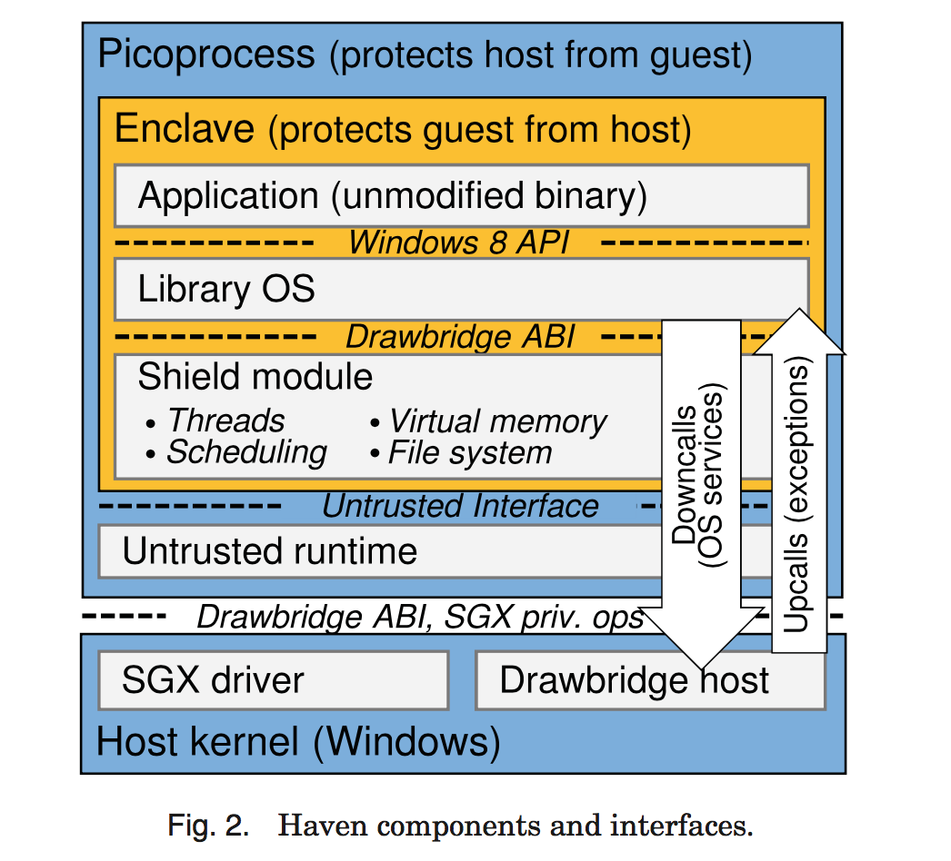
Haven in Practice
Drawbridge
LibOS.
Fully verifiable by application!
Shield module
Kernel primitives.
Validates host services.
First thing loaded.
Untrusted runtime
Forwards calls.
Bootstrap.
Notes:
So how do they do that?
The figure on the right presents the overall design of Haven.
The application runs within a sandbox provided by drawbridge called "picoprocess".
A modified version of Windows 8 was retroffited into a Library operating system and provides all the os services required by the application.
This LibOS is fully verifiable by the application!
It interacts with the shield module, the part that is responsible for providing kernel primitives and abstractions such as threads, virtual memory, scheduling etc.
The shield module is responsible for validating every interaction with the host os. Basically what it means is that it is going to check that any request to the host returns a reasonable result.
All of this is wrapped within the enclave.
You then have the untrusted runtime, responsible for forwarding calls.
It also acts as glue code and bootstrap module.
Deployment.

Slide 25
Haven Discussion
Good
Less good…
Separation between H&G.
Legacy applications.
Attestation.
Performance penalty ~ 2X.
Enclave crossings.
Dynamic memory allocation.
EPC.
Should re-evaluate on hardware.
Still relies on some host services.
Notes:
Let’s see the take aways.
Haven enforces a separation between the Host & the guest that allows to leverage the Intel SGX feature to provide bi-directional isolation.
It is really important to separate these two entities as much as possible to efficiently allow mutual distrust.
Then it supports legacy applications, which means that this increased confidentiality comes transparently.
Finally, the attestation mechanisms allows to verify remotley the integrity of the system.
However, this does not come for free-
Haven incurs a performance slowdown of approximately 2X, due to a combination of enclave crossings, dynamic memory allocation, and access to the EPC.
While some of the overheads are directly imputable to the hardware, Haven’s design also introduces non-negligible slowdowns.
It packs an entire OS within the enclave, has multiple layers that each interact in complex ways.
At the same time, Haven relies on the host for certain services, such as access to external devices or to the tiem, which impact both performance and flexibility.

Slide 26
Comparisons
Exokernel
Unikernel
Share design principles.
Cleaner separation H&G.
Revocation mechanism.
Scarce enclave pages!
Seal memory mappings.
No need for dynamic alloc.
Small size.
Less enclave pages for code&data.
Both allow application-specific implementation of system abstractions!
Notes:
However, if we compare it with the previous papers, we discover similarities in terms of high level design.
First, it shares common design principles with the exokernel, that is, separating policies & mechanisms and protection from management.
The exokernel, however, presents a cleaner separation between the host & guest, which makes it an interesting environment to try and implement bi-directional mistrust.
In fact, the interactions between the host and guest are supposed to be limited to the binding of resources, hence making it easier to draw the line between the two mutually distrustful entities and monitor their interactions.
Another interesting point is that the exokernel already provides mechanisms for scarce resources.
Haven doesn’t not implement preemption on enclave pages and is therefore limited by the initial size of the EPC.
The exokernel revocation protocol could be leverage alleviate this limitation.
We also see that unikernels enable to remove some of Haven’s limitations.
First, they already provide mechansims to seal the memory mappings and avoid dynamically allocating memory, or changing mappings (which both require the host’s intervention in Haven and hence produce overheads).
Second, unikernels are small size appliances, they therefore require less enclave pages to host the code and data than Haven, which packs the entire Windows 8 operating system.
We also note that, contrary to Haven, both the exokernel and the unikernel allow application-specific implementations of system abstractions, which is our fundamental requirement for performance.

Slide 27
Conclusion
A modern system must:
Allow application-specific mgmt of resources.
Don’t fix the abstractions!
Separate P&M + P&M.
Take into account modern deployments & hardware setups.
Virtualization has to play a role.
Answer present-day security concerns.
Isolate H&G.
SGX & the likes.
Notes:
So if we summarize, from the exokernel we learned that
we must allow applications to manage their resource and avoid fixing high-level abstractions.
This is achieved by separating the host from the guest, protection from management, and policies from mechanisms to preserve flexibility.
Then, we’ve seen that virtualization can help cope with the heterogeneity of modern hardware setups and deployment paradigms (like the cloud).
Finally, with Haven, we have seen that in order to provide bi-directional isolation, we must provide a clean separation between the host & the guest, limit their interactions, and rely on hardware features such as Intel SGX.
This gives us the requirements & design principles for our modern system.

Slide 28
Research Proposal
Rely on modern hardware features to implement such a system.
Performance & flexibility. (P&M + P&M)
Hardware support for virtualization: VT-x, VT-d.
Safely expose to application.
Portability for cloud & hardware setups.
Virtualization helps.
Security.(P&M)
Separate H&G.
SGX transparently integrated.
Notes:
My research proposal is to try to provide such a system by leveraging the recent hardware features that appeared.
To find the sweet spot that allows application-level management of resources and a great design flexibility, I propose to explore solutions based on hardware support for virtualization (such as Intel VT).
Relying on virtualization further helps with portability over diverse platforms and cloud services.
It also provides isolation guarantees that will help in providing bi-directional isolation.
For security, I propose to transparetly integrate SGX or a similar feature, that would leverage the enforces separation between the host & guest to answer modern security concerns.

Slide 29
Thanks!
Notes:
That’s all. Thanks

